Slide 1
Survey of Vision-Language-Action (VLA) Models
刘峥 2025.11.21

Slide 2
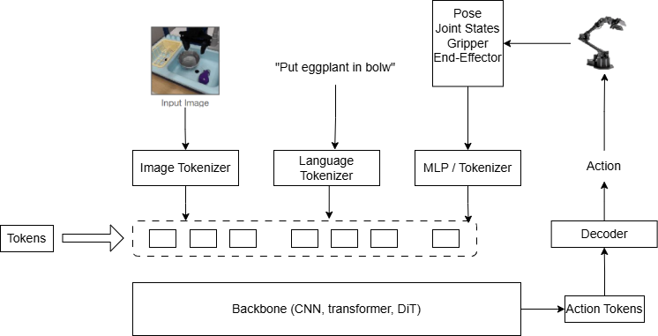
Background & Definition:
Definition: VLA is defined as any model capable of processing multimodal inputs from vision, language and action to product robot actions that accomplish embodied tasks.
Why do we need VLA?
Traditional robotics lack generalizability.
VLMs provides strong semantic understanding
Backbone:
Image Tokenizer:
ViT patch embed
SigLIP / CLIP ViT-L
DinoV2
Language Tokenizer:
SentencePiece (Google T5)
LLaMa Tokenizer
CLIP
VLA Backbone: Unet, transformer, diffusion transformer
Notes:
这里介绍背景，首先引入VLA这个工作，然后讲清楚VLA的pipeline，这个抽象的workflow.
早期VLA的论文工作，核心内容就是其如何实现vision – language-action 对齐的。

Slide 3
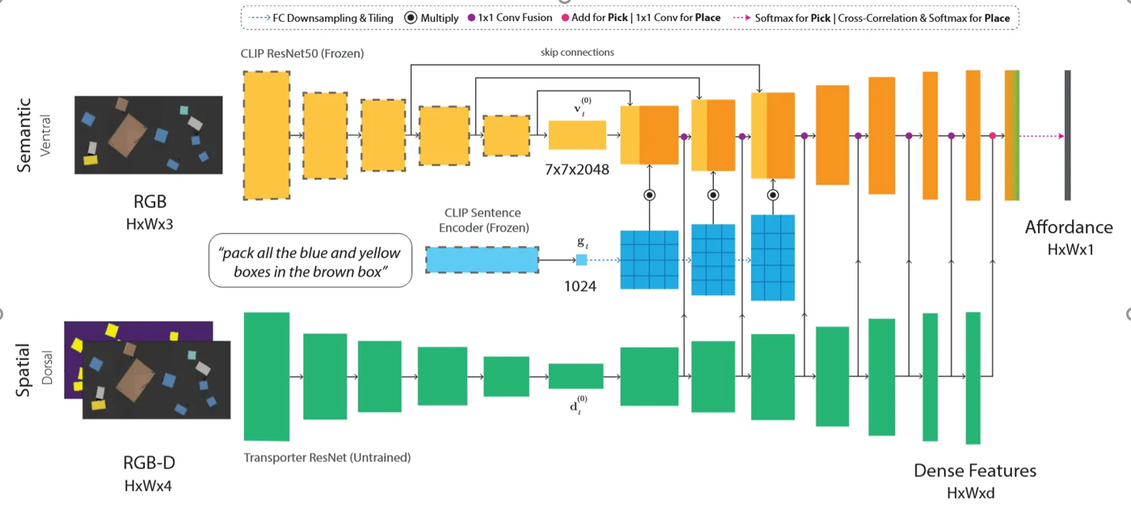
Early Explorations (2021-2023)
2021:Unet-based model
CLIPort: early VLA grounding
Notes:
在Sematic stream中，图片和文本分别经过视觉编码器（ViT或ResNet）和文本编码器（Transformer）编码得到2个embedding，$f_I$ 和$f_L$；
在Spatial stream中，RGB-D经过一个未训练的ResNet-like backbone得到特征 $f_d$，然后laterally fused 到semantic stream中；
在每一层，$f_I$ 和$f_L$经过cross-attention fuse 得到语义特征图 $F=Fuse(f_I,f_L)$ ，然后再与 $f_d$进行1×1 conv最后经过若干层后得到affordance map，其中每个像素表示“这里是否适合pick/place”。这里有一个信息点：”之所以能够用一个map直接表示这个信息是因为所有的操作都是在桌面上进行的（如上图所示）“

Slide 4
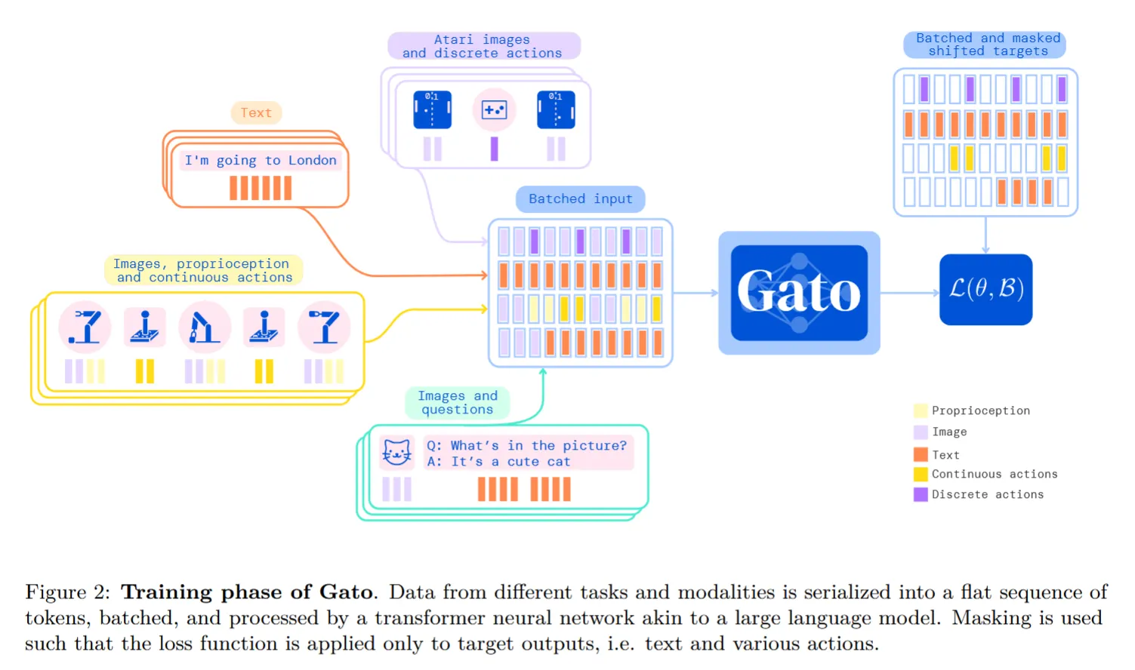
Early Explorations (2021-2023)
2021:Unet-based model
CLIPort: early VLA grounding
2022: Transformer-based autoregressive models
Gato
VIMA
Notes:
其他离散的数据scale到[0,1024), 连续的数据，例如关节数据scale到(32000, 33024)。

Slide 5
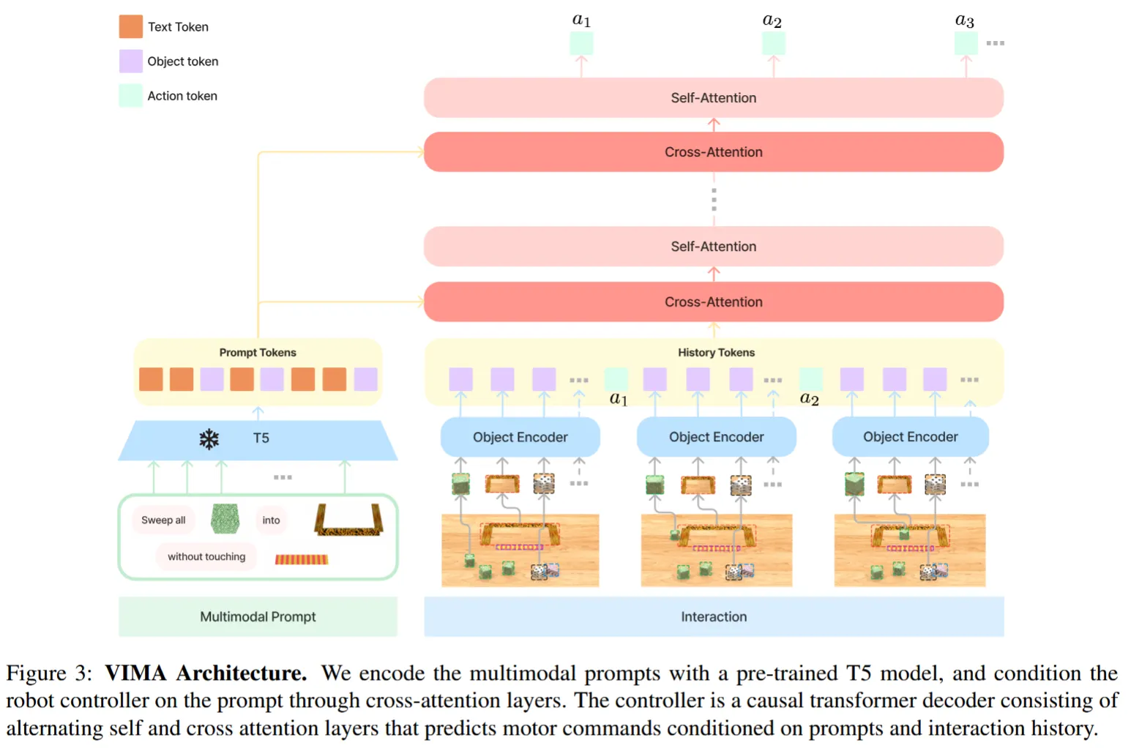
Early Explorations (2021-2023)
2021:Unet-based model
CLIPort: early VLA grounding
2022: Transformer-based autoregressive models
Gato
VIMA
Notes:
总结：transformer这两篇代表性的工作有2个关键词，“tokenization”和“自回归生成”，即将各种输入模态转化为token然后通过自回归网络序列生成action policy。transformer基于“相似性计算以及统计”的方法确实赋予了模型一定程度的泛化性和任务规划的能力，但是其对时间、空间以及物理规律一无所知，这使得Gato和VIMA这两个工作在短期任务上能有良好的表现，但是当action step超过了20后，成功率就会显著降低。

Slide 6
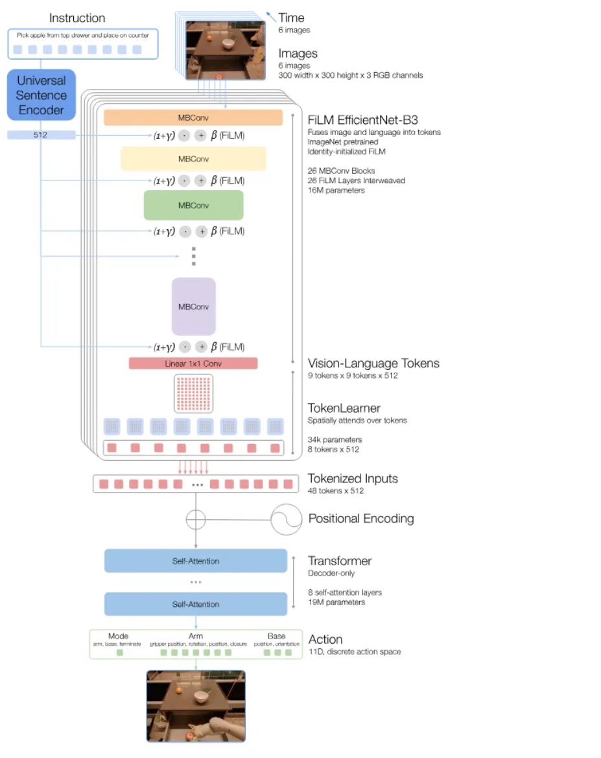
Early Explorations (2021-2023)
2021:Unet-based model
CLIPort: early VLA grounding
2022: Transformer-based autoregressive models
Gato
VIMA
2023:
RT-1
RT-2
RT-Series

Slide 7
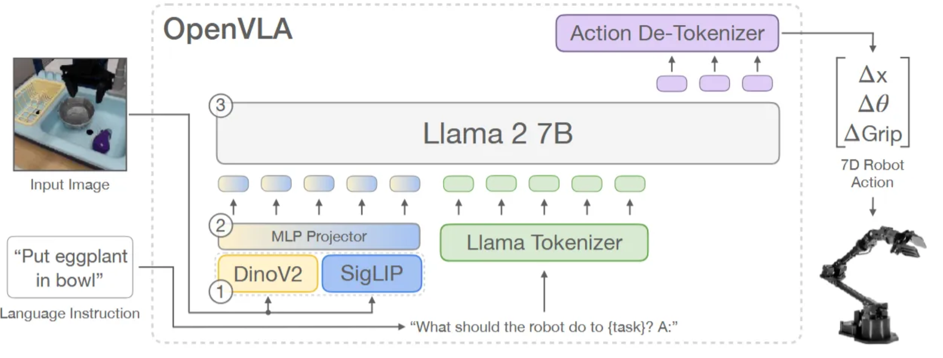
Early Explorations (2021-2023)
2021:Unet-based model
CLIPort: early VLA grounding
2022: Transformer-based autoregressive models
Gato
VIMA
2023:
RT-1
RT-2
RT-Series
OpenVLA
Diffusion Policy

Slide 8
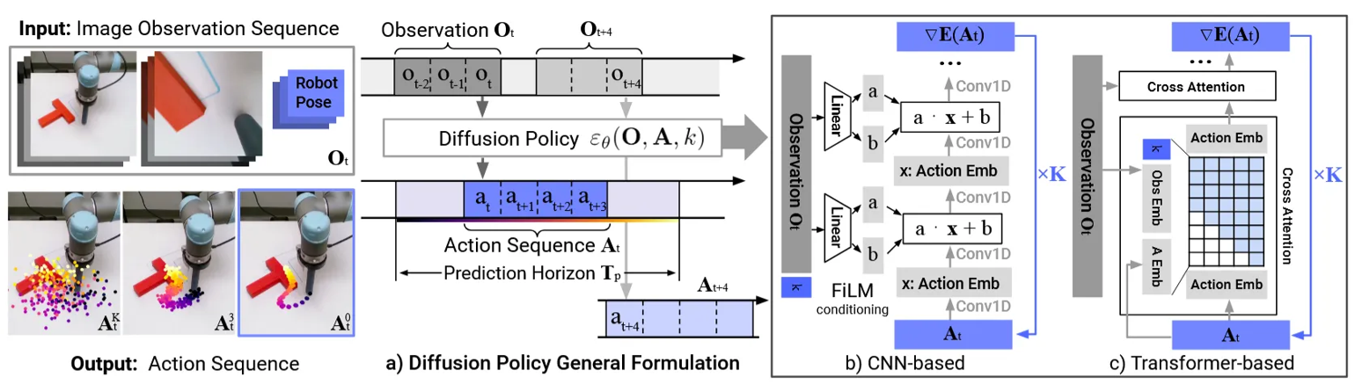
Early Explorations (2021-2023)
2021:Unet-based model
CLIPort: early VLA grounding
2022: Transformer-based autoregressive models
Gato
VIMA
2023:
RT-1
RT-2
RT-Series
OpenVLA
Diffusion Policy

Slide 9
Summary of Early Explorations (2021-2023)
From 2021 to 2023
A unified VLA framework was established.
Large-scale, multi-task pipelines became mature.
Model success rates improved significantly.
Selections on backbones.
Remaining Challenges:
Long-horizon tasks remain unsolved
Model are too large to inference on edge devices.
Model | CLIPort | Gato | VIMA | RT-1 | RT-2 | OpenVLA | Diffusion Policy
Size | 150M | 1.2B | 200M | 35M | 55B | 7B | 1B
Generalizability | × | × | × | √ | √ | √ | √

Slide 10
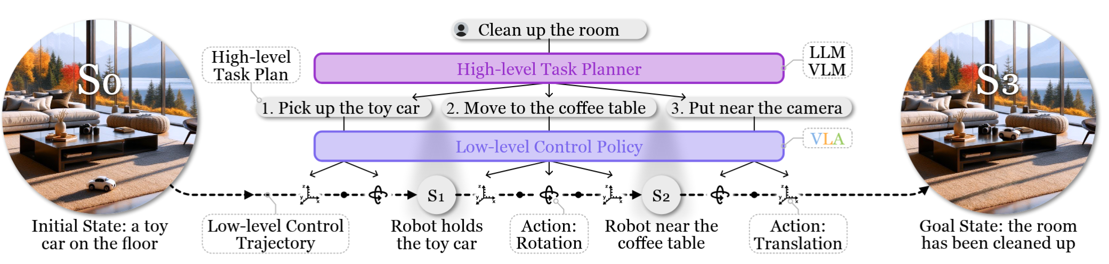
Architectures Innovations (2024-2025)
Notes:
Groot N1 设计了一个双系统的架构(模型总大小为2B)，System 2（1.34B），system 2的延迟可以低到10ms.

Slide 11
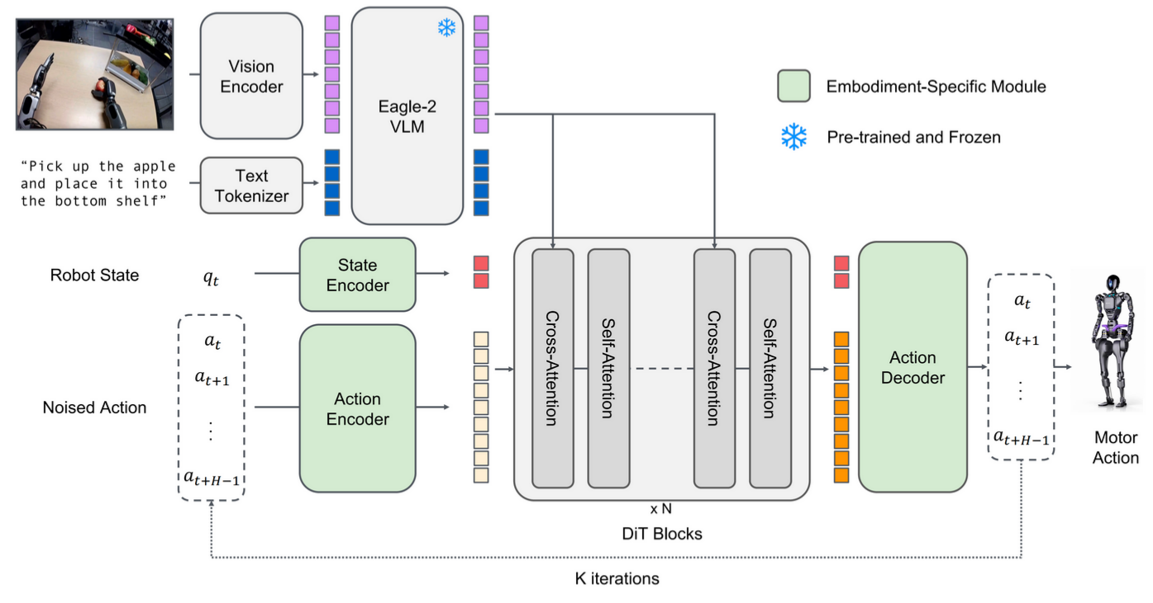
Architectures Innovations (2024-2025)
2024:
RT-H: motion language, like “move arm forward”
2025:
Groot N1: dual-system architectures
Notes:
Groot N1 设计了一个双系统的架构(模型总大小为2B)，System 2（1.34B），system 2的延迟可以低到10ms.

Slide 12
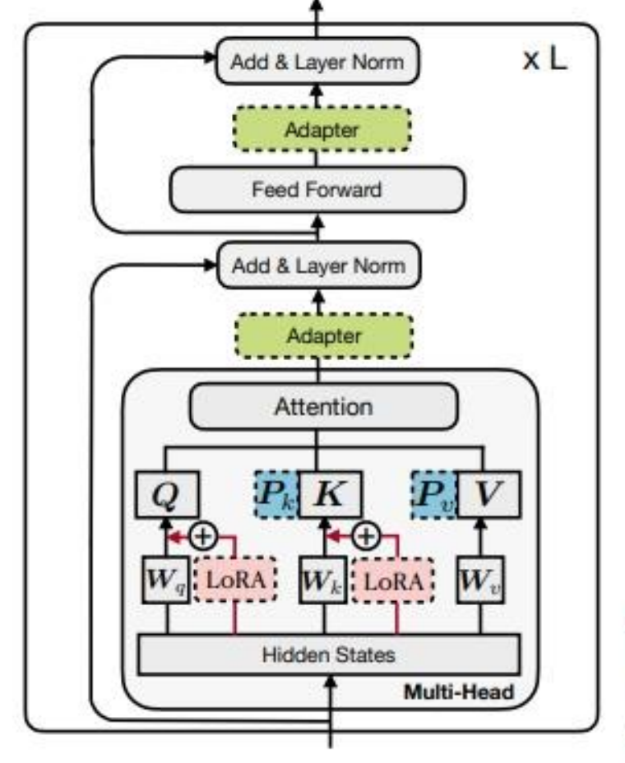
Feasible Optimizations
LoRA: OpenVLA
Quantization: OpenVLA-7B uses INT8 quantization and achives an average success rate of 97% on the Orin NX.
Model Pruning
FAST
Parallel Decoding and Action Chunking
Model Pruning

Slide 13
Thank you!

